Slide 1


USERNAME
PASSWORD

Slide 2


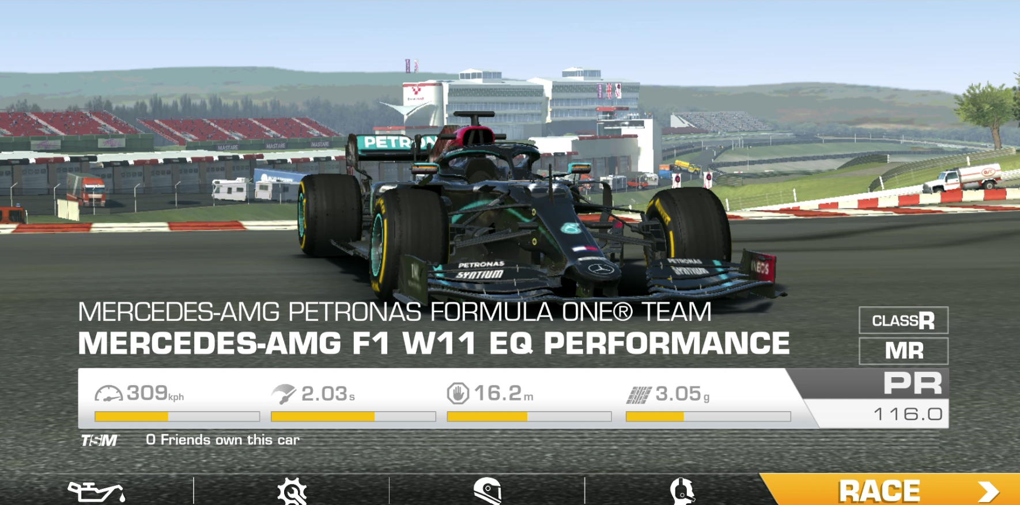

ROHIT SHARMA
PERFORMANCE FOR THE MONTH OF
JUNE
THESE WILL BE YOU METRIC SCORES
YOUR STANDINGS
CHAMPIONS
TEAM CHAMPS
PRACTICE TRACKS
RANKING
SHOP

Slide 3
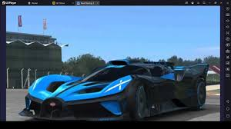

ROHIT SHARMA
JUNE-24
YOUR STANDINGS
RANK
02
EARNINGS
BADGES
RACE WON
ASSESSMENTS
2,345
5
25
4|7
YOUR STANDINGS
CHAMPIONS
TEAM CHAMPS
RANKING
SHOP

Slide 4
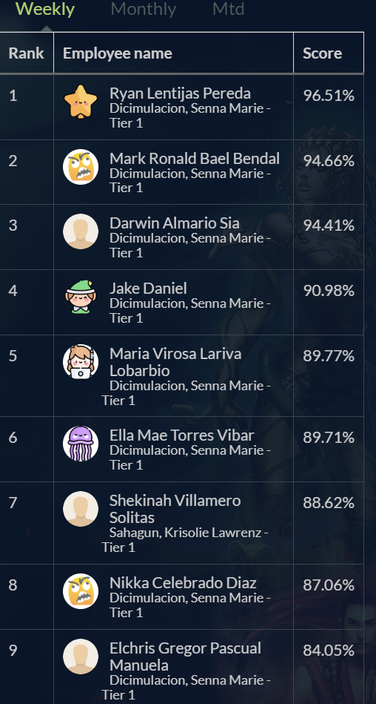
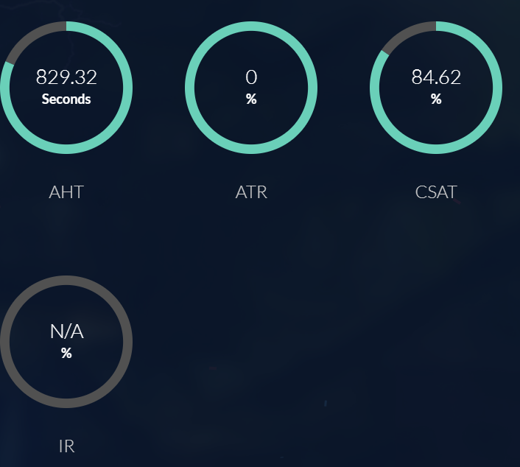
ROHIT SHARMA
JUNE-24
CHAMPIONS
SCORE
47.3%
YOUR STANDINGS
CHAMPIONS
TEAM CHAMPS
RANKING
SHOP

Slide 5
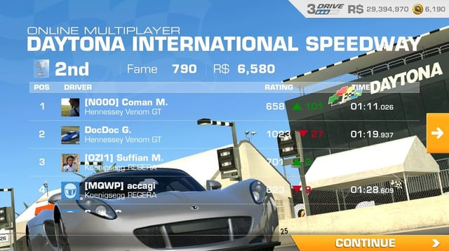
TEAM CHAMPS
YOUR STANDINGS
CHAMPIONS
TEAM CHAMPS
RANKING
SHOP

Slide 6

ROHIT SHARMA
YOUR STANDINGS
CHAMPIONS
TEAM CHAMPS
RANKING
SHOP

Slide 7

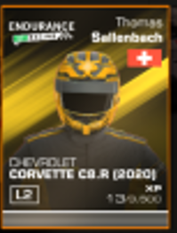

REWARDS TO RACE
STATISTICS
50
CHOOSE THE TRACK TO RACE
YOUR STANDINGS
CHAMPIONS
TEAM CHAMPS
RANKING
SHOP

Slide 9

ROHIT SHARMA
PRACTICE AREA
TRACK – NEW DELTA FEATURES
JULY-19
NEW TRACKS
TRACK – FEES & COMMISSIONS
JULY-9
5
YOUR STANDINGS
CHAMPIONS
TEAM CHAMPS
RANKING
SHOP

Slide 10
ROHIT SHARMA
TRACK – NEW DELTA FEATURES
QUESTION : WHAT IS THE NAME OF RAVAN’S SISTER?
GANDHARI
SRUPNAKHA
KUNTI
QUESTION : WHAT IS THE NAME OF RAVAN’S SISTER?
GANDHARI
SRUPNAKHA
KUNTI
QUESTION : WHAT IS THE NAME OF RAVAN’S SISTER?
GANDHARI
SRUPNAKHA
KUNTI
QUESTION : WHAT IS THE NAME OF RAVAN’S SISTER?
GANDHARI
SRUPNAKHA
KUNTI
BACK
SAVE
SUBMIT

Slide 11
ROHIT SHARMA
PRACTICE AREA
TRACK – NEW DELTA FEATURES
JULY-19
85%
NEW TRACKS
TRACK – FEES & COMMISSIONS
85%
JULY-9
5

